Slide 1
Nursery Landsacpe CDE
Study PowerPoint
Central Region
Area – Senior
2015

Slide 2
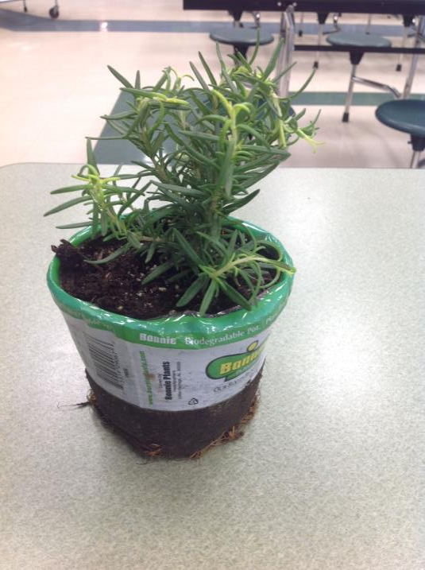
Rosemary

Slide 3
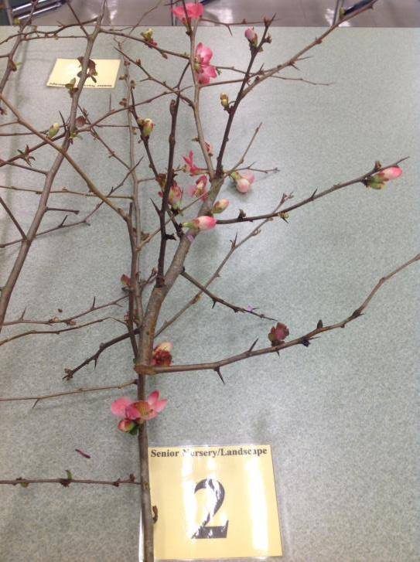
Flowering Quince

Slide 4
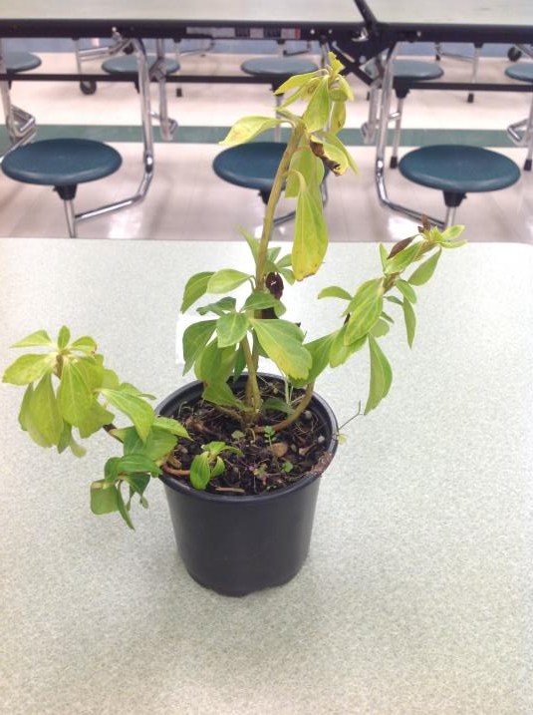
Pachysandra

Slide 5
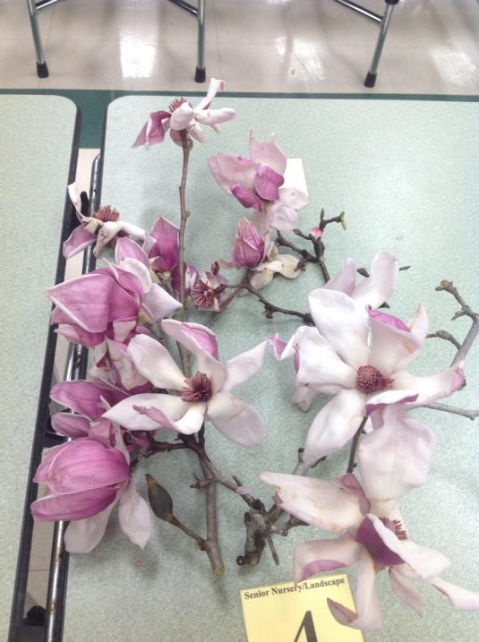
Saucer Magnolia

Slide 6
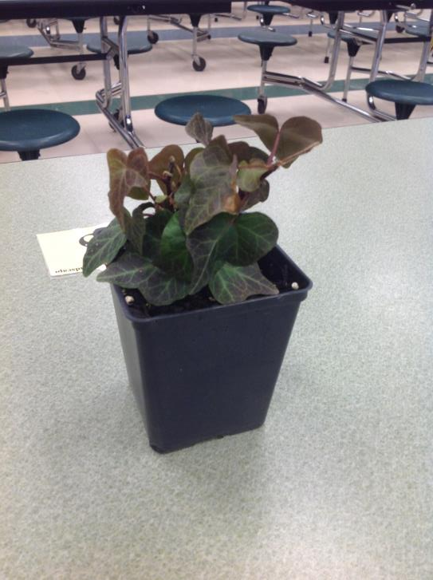
English Ivy

Slide 7
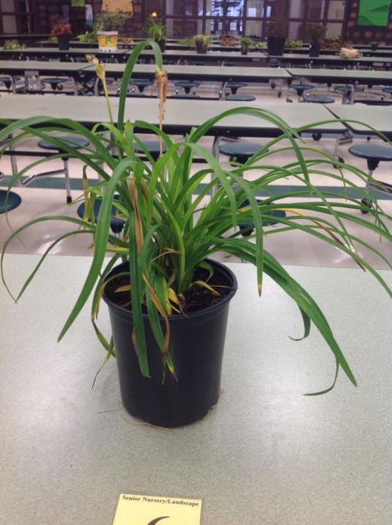
Daylily

Slide 8
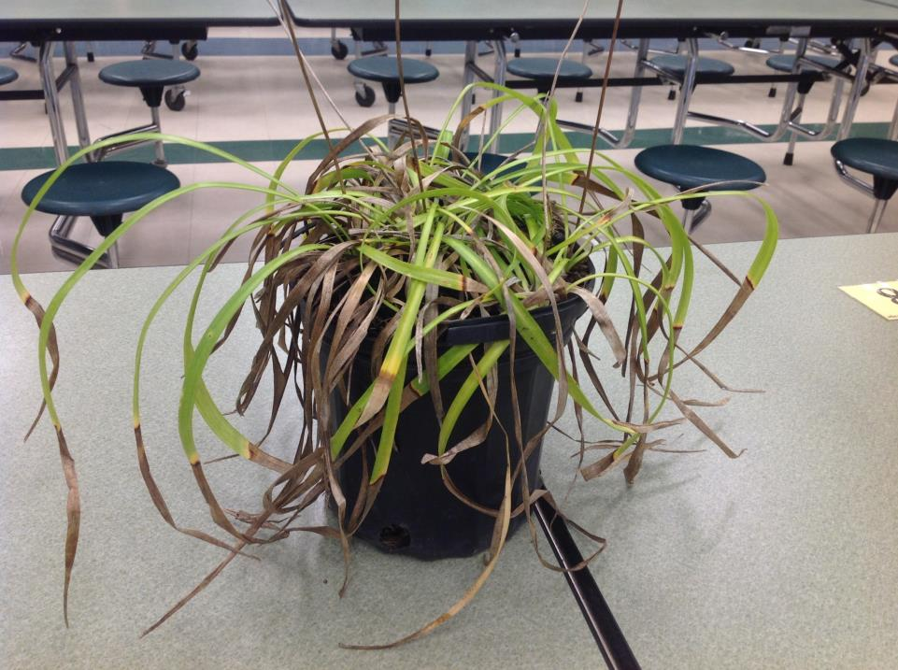
Liriope

Slide 9
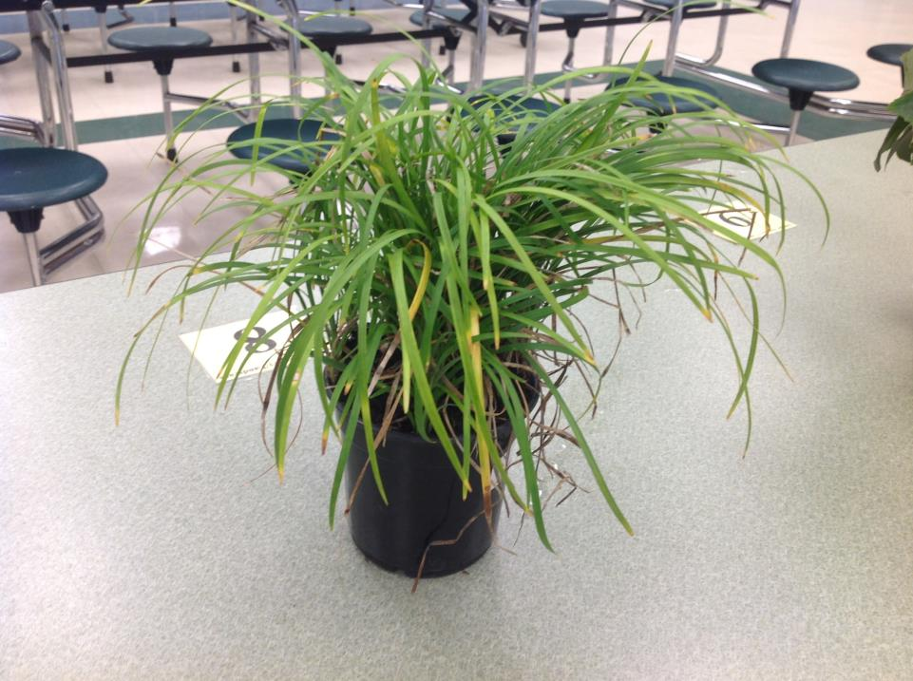
Mondo Grass

Slide 10
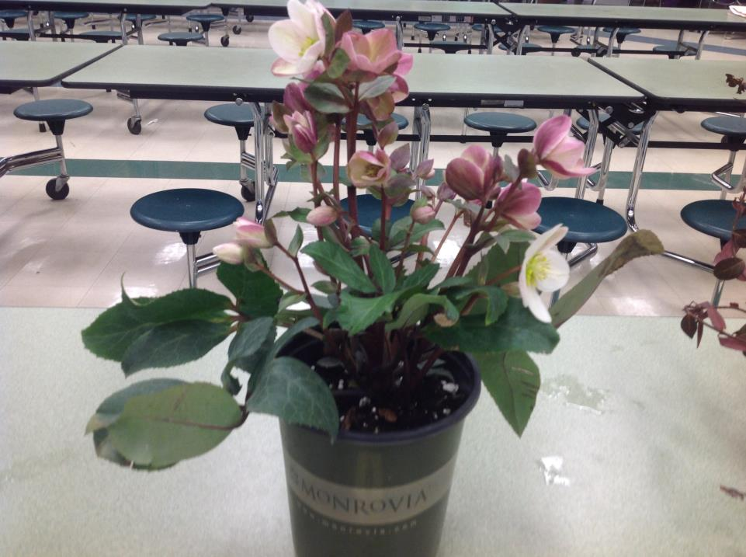
Lenten Rose

Slide 11
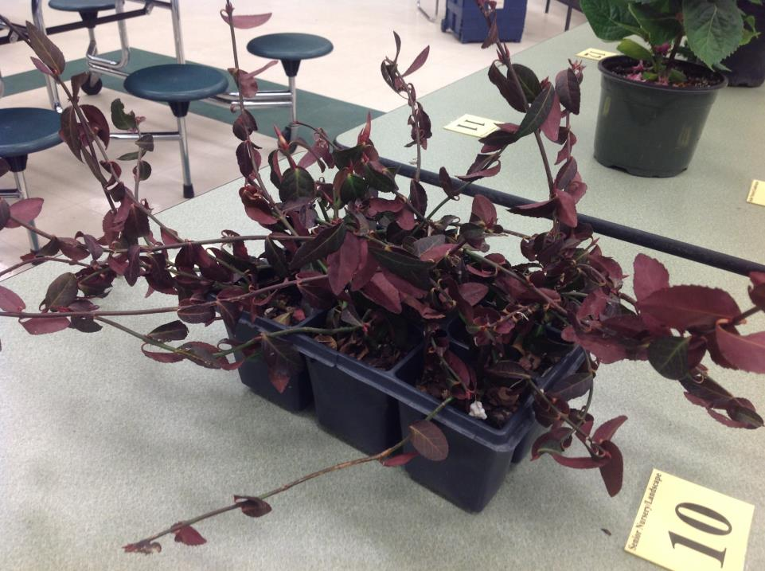
Wintercreeper

Slide 12
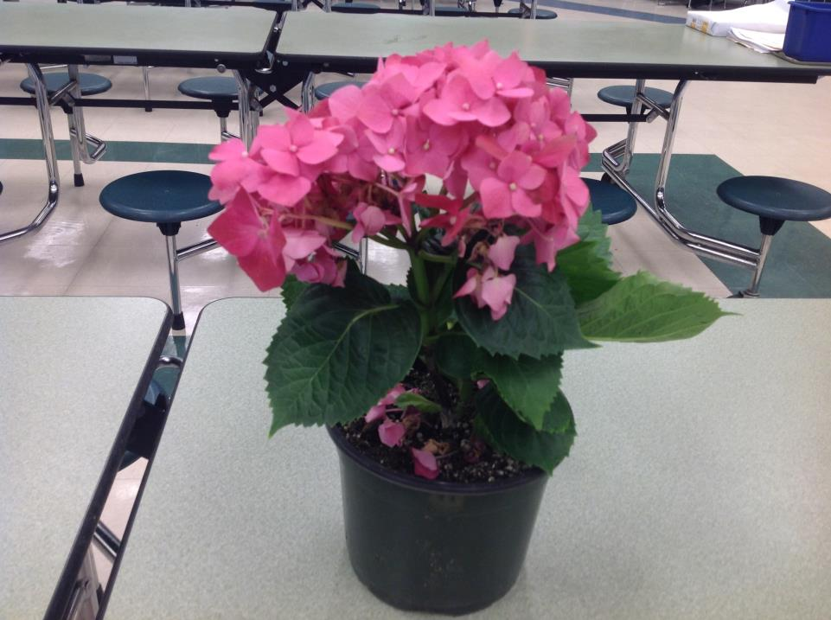
Bigleaf Hydrangea

Slide 13
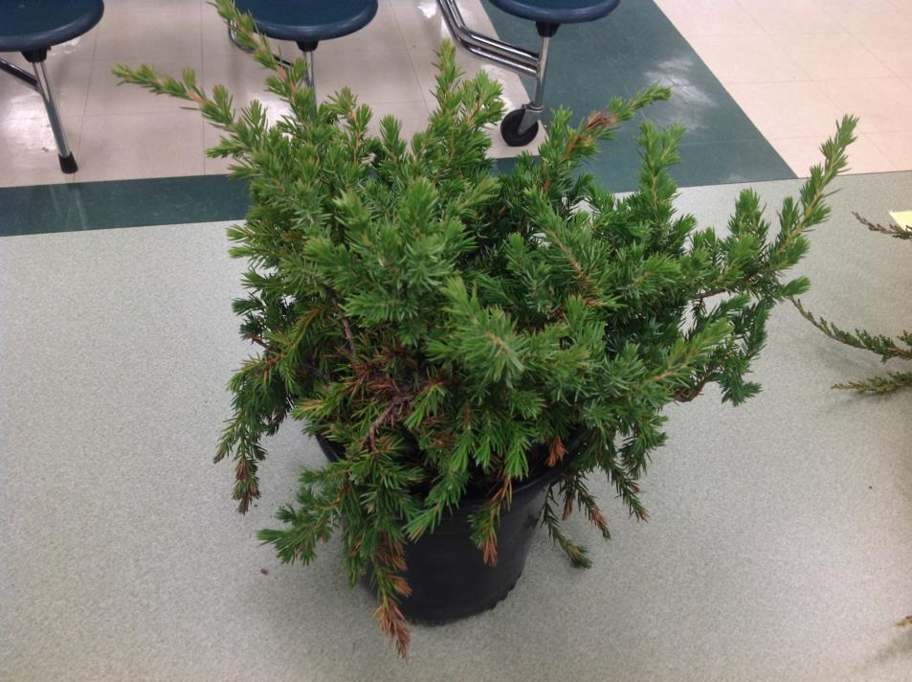
Shore Juniper

Slide 14
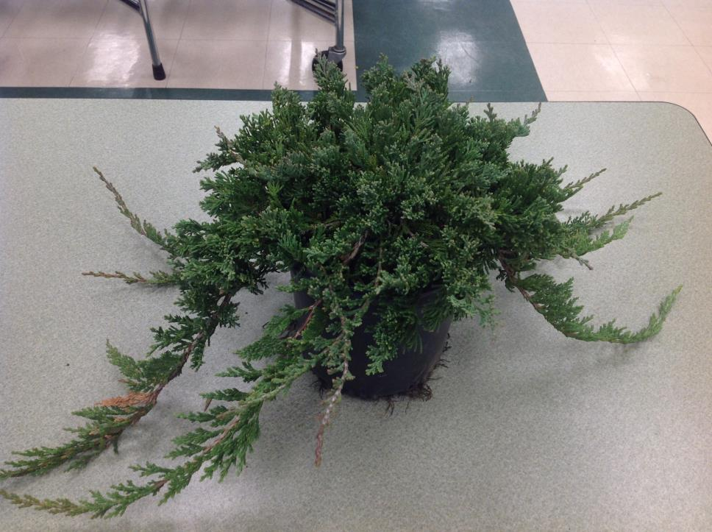
Blue Rug Juniper

Slide 15
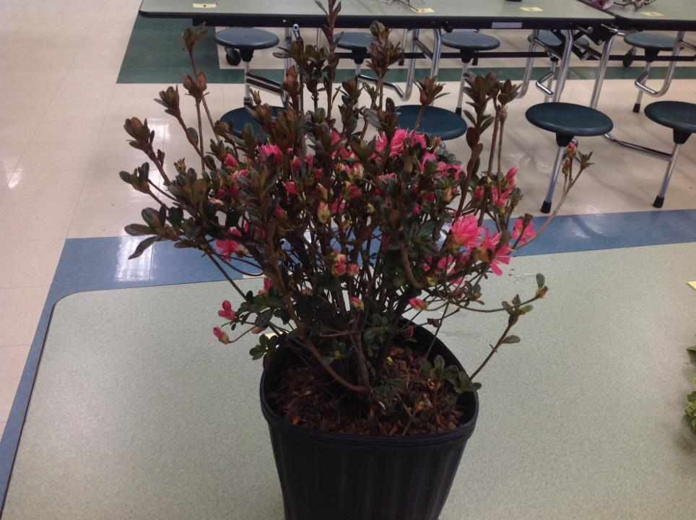
Kurume Azalea

Slide 16
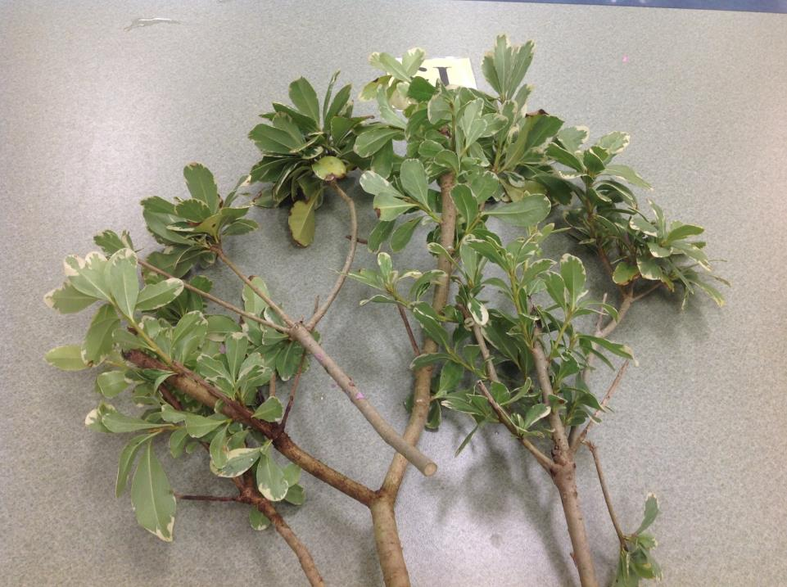
Japanese Pittosporum

Slide 17
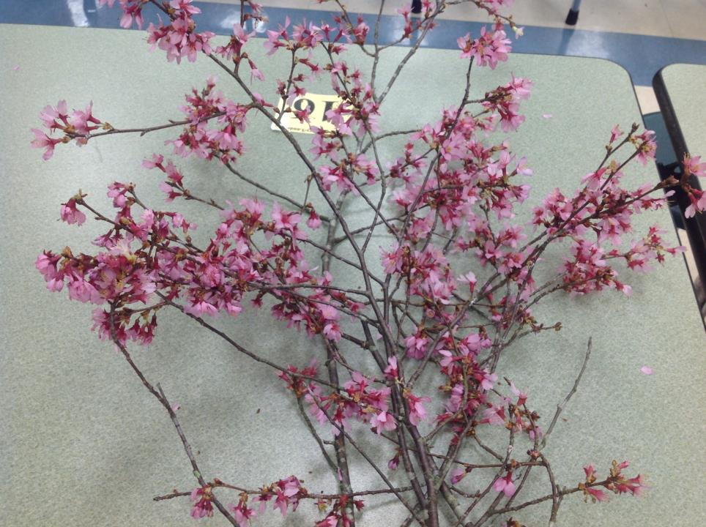
Japanese Flowering Cherry

Slide 18
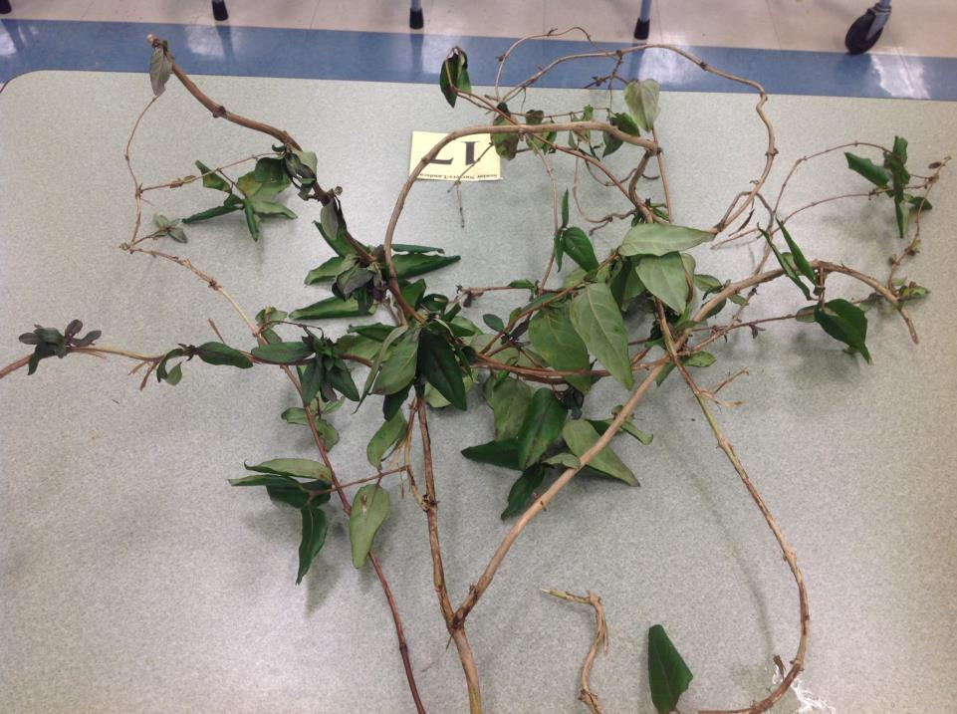
Japanese Honeysuckle

Slide 19
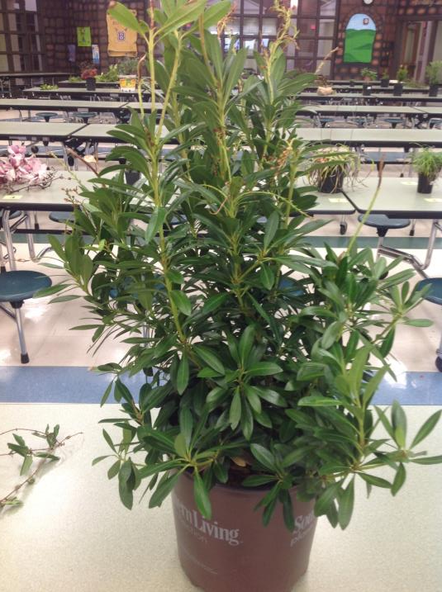
Pieris

Slide 20
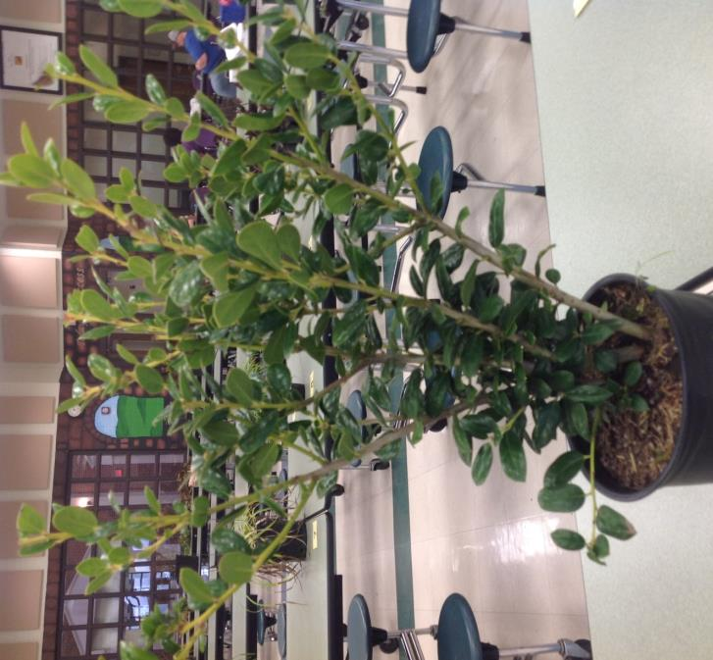
Dwarf Burford Holly

Slide 21
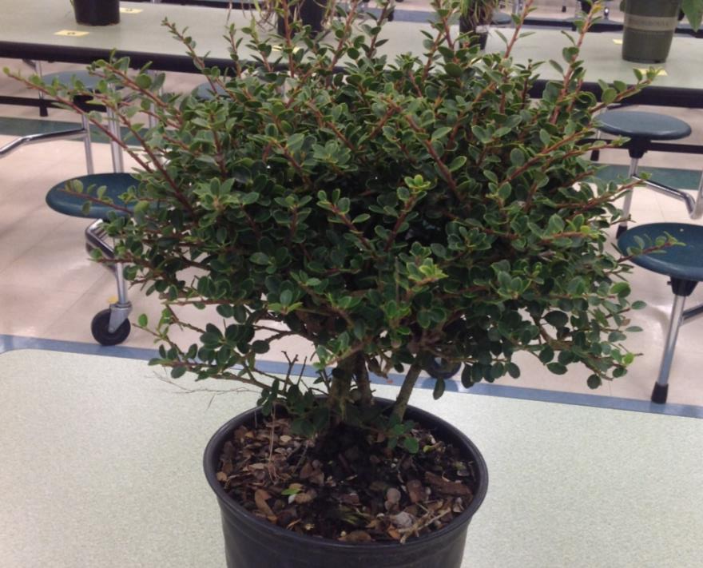
Helleri Holly

Slide 22
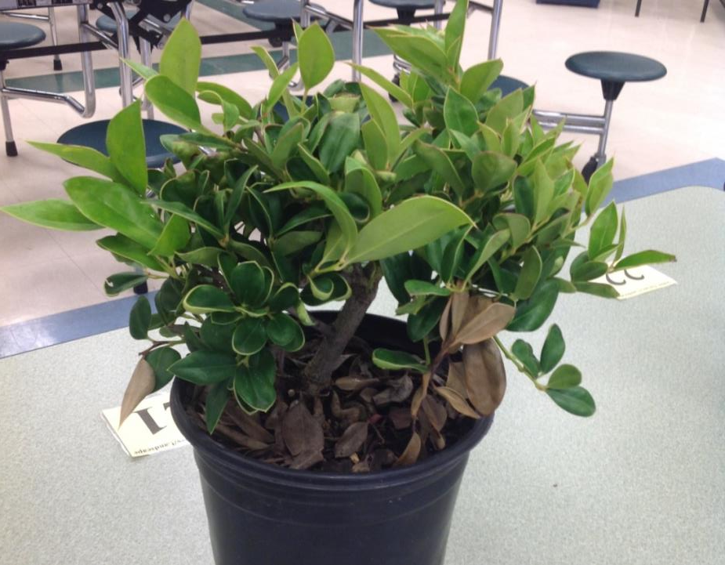
Carissa Holly

Slide 23
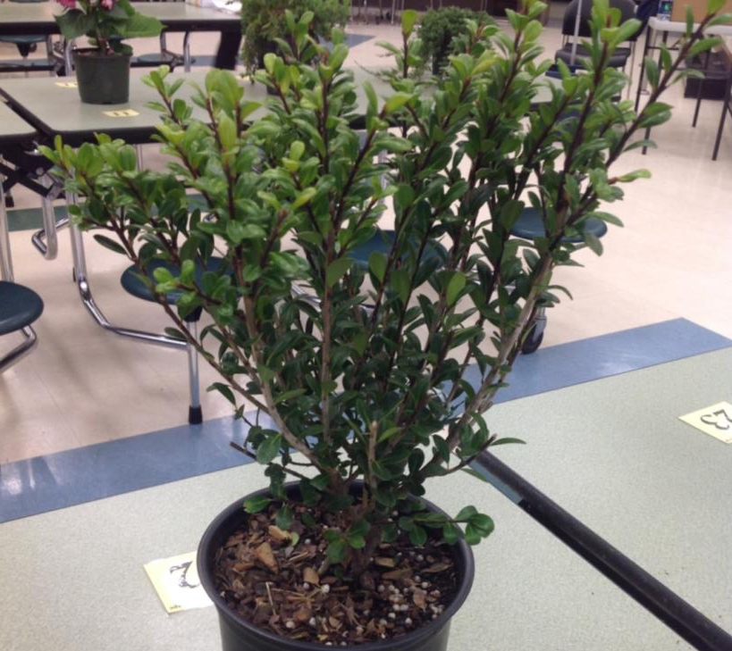
Compacta Holly

Slide 24
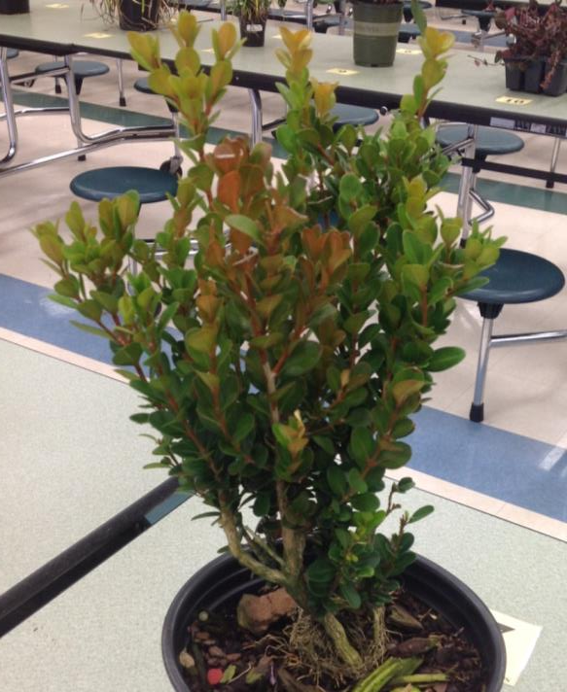
Boxwood

Slide 25
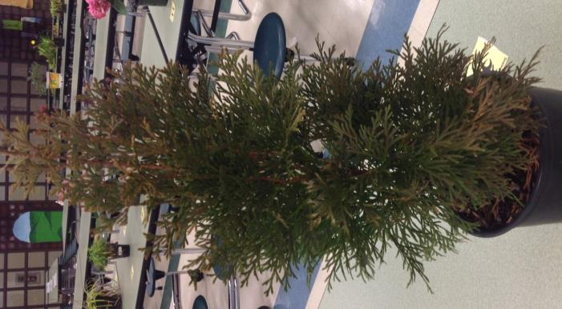
Arborvitae

Slide 26
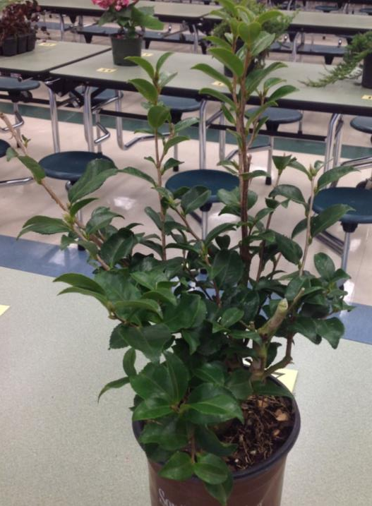
Sasanqua Camellia

Slide 27
Disorders

Slide 28
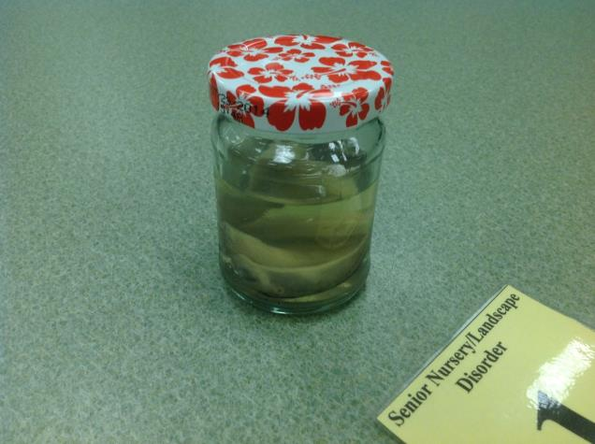
Slugs

Slide 29
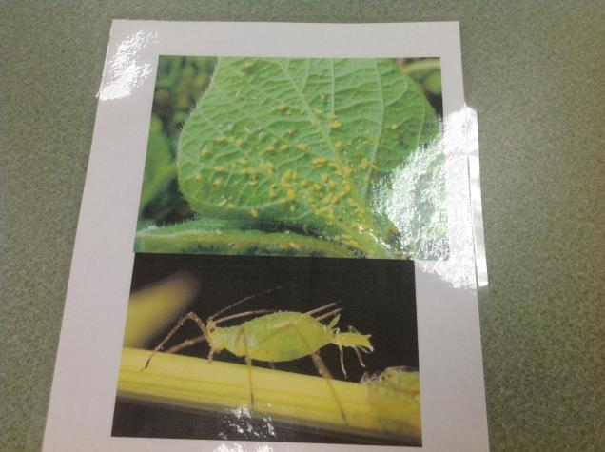
Aphids

Slide 30
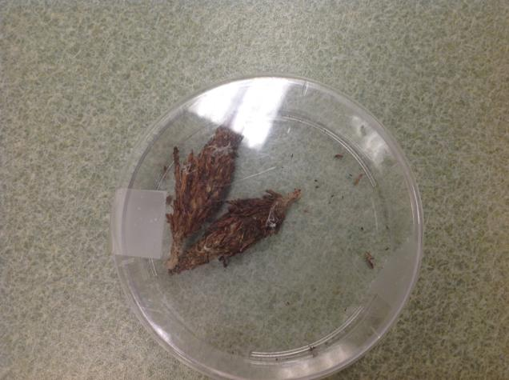
Bagworm

Slide 31
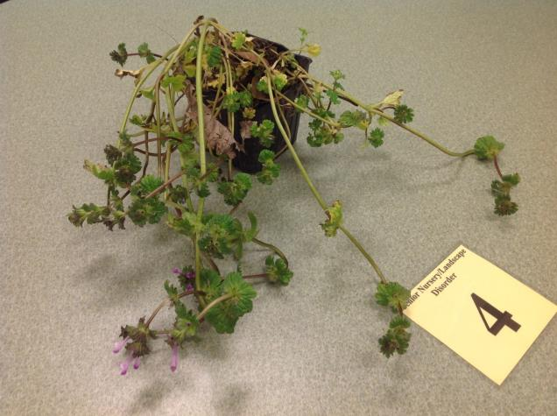
Henbit

Slide 32
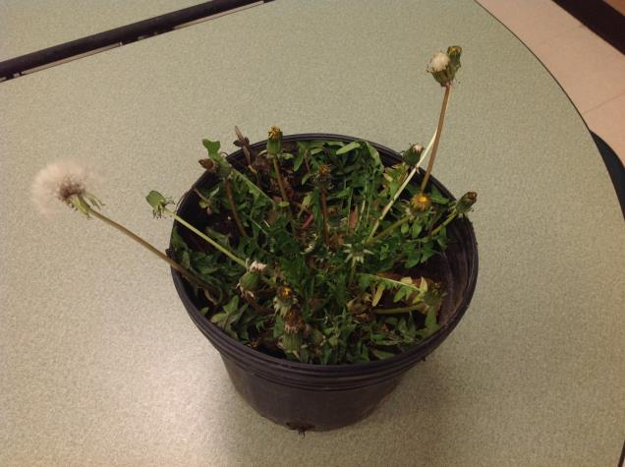
Dandelion

Slide 33
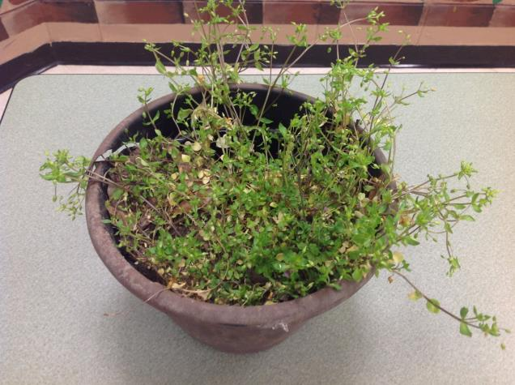
Chickweed

Slide 34
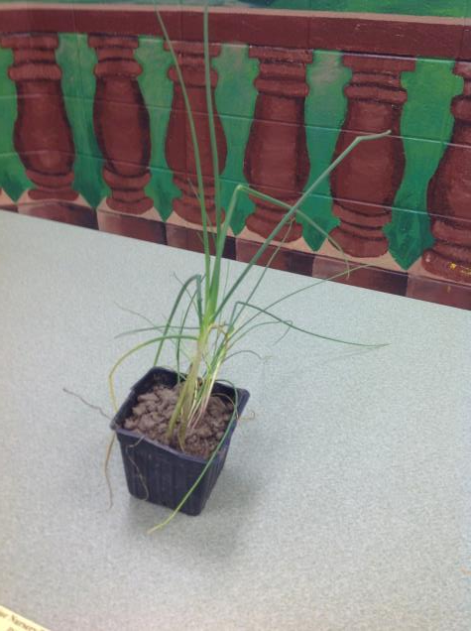
Wild Garlic/ Onion

Slide 35
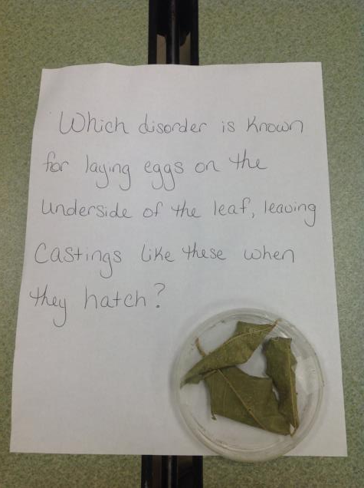
Whiteflies

Slide 36
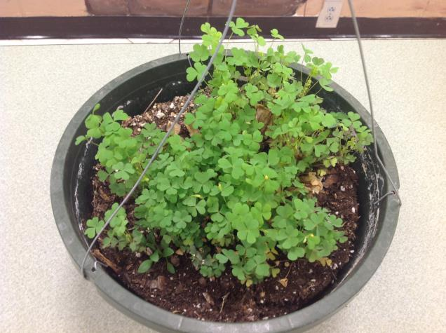
Oxalis

Slide 37
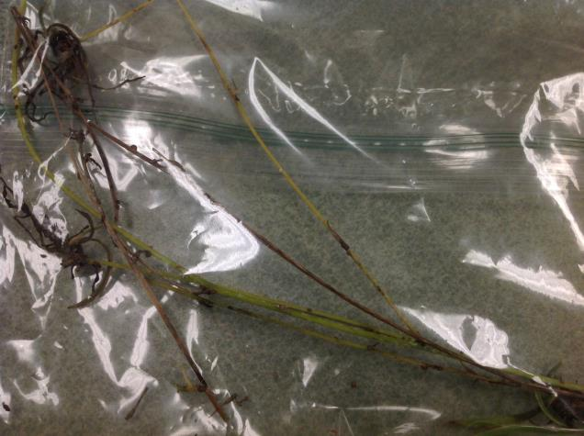
Scale

